Slide 1
GTest

Slide 2
Google Test
A library for writing c++ tests
An XUnit test framework
Open-source with new BSD license

Slide 3
Features
A library for writing c++ tests
Open-source with new BSD license
An XUnit test framework
A rich set of assertions
User-defined assertions.
Death tests.
Fatal and non-fatal failures.
Value-parameterized tests.
Type-parameterized tests.
Various options for running the tests.
XML test report generation.
Data taken from https://github.com/google/googletest/

Slide 4
Why Google Test
Independent and repeatable,
Tests should be well organized and reflect the structure of the tested code
Tests should be portable and reusable.
When tests fail, they should provide as much information about the problem as possible.
Tests should be fast.
Large community of supporters

Slide 5
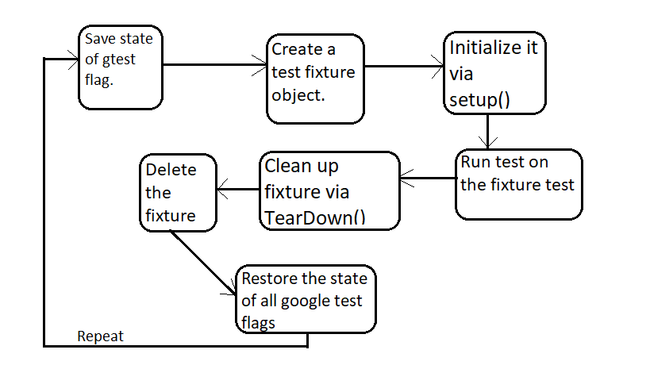
Architecture

Slide 6
Reusing the same data configuration
Use set-up and tear down logic in a test fixture class - dont neet to repeat it at every test
Google test creates a fresh object for each test - tests won’t affect each other.
Example : path(“code/Testing Tools/ Boost and Google Test/t7 ”)

Slide 7
Assertions
Basic Assertions: ASSERT_TRUE(cond), EXPECT_TRUE(cond),ASSERT_FALSE(cond)
Binary Comparison: ASSERT_EQ(val1,val2), ASSERT_NE(val1,val2),ASSERT_LT(val1,val2),
ASSERT_LE(val1,val2)
String Comparison: ASSERT_STREQ(str1,str2), ASSERT_NE(str1,str2), ASSERT_STRCASEEQ(str1,str2) , ASSERT_STRCASENE(str1,str2),
More about assertion can be found here

Slide 8
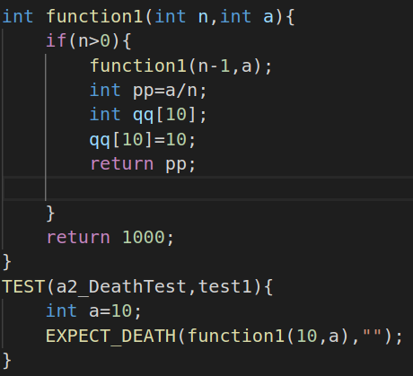
Death Tests
In many applications, there are assertions that can cause application failure if a condition is not met.
If a piece of code throws an exception, we don't consider it "death" for the purpose of death tests,
Image ///////////// t4
Assertions:
EXPECT_DEATH(val, regx)
ASSERT_DEATH_IF_SUPPORTED(statement, regex);
ASSERT_EXIT(statement, predicate, regex);

Slide 9
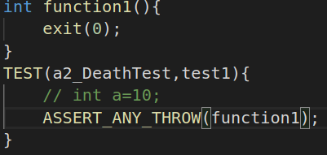
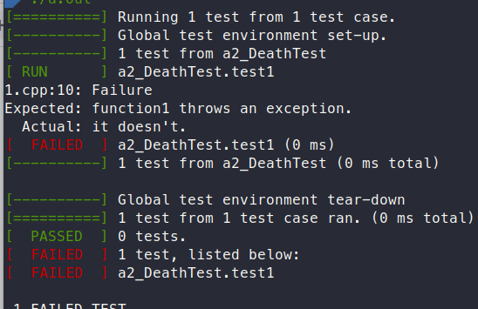
Exception Test
These are for verifying that a piece of code throws (or does not throw) an exception of the given type.
ASSERTIONS:
ASSERT_THROW(statement, exception_type);
ASSERT_ANY_THROW(statement);
ASSERT_NO_THROW(statement);

Slide 10
Google Mock
An extension for writing and using c++ mock classes.
supports a rich set of matchers and actions.
handles unordered, partially ordered, or completely ordered expectations.
is extensible by users.
Google Mock is implemented on top of Google Test, and depends on it. You must use the bundled version of Google Test when using Google Mock.

Slide 11
Google Mock (Features)
Provides a declarative syntax for defining mocks.
Handles functions of arbitrary types and overloaded functions.
Can easily define partial (hybrid) mocks, which are a cross of real and mock objects.
Lets a user extend it by defining new matchers and actions.
Does not use exceptions.

Slide 12
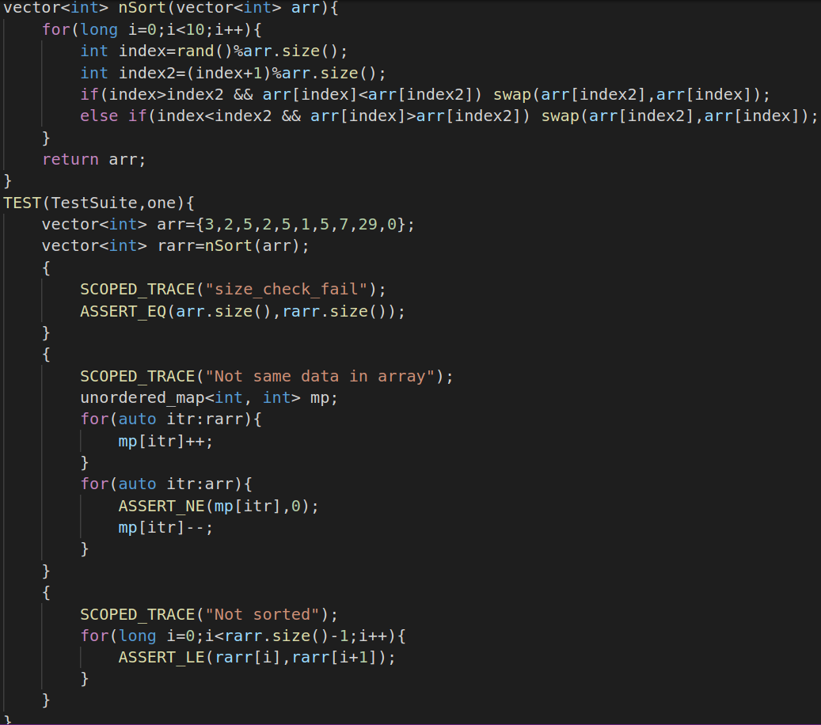
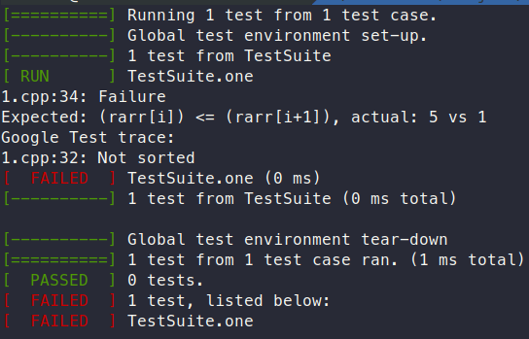
Test Example 1
Add for loop example

Slide 13
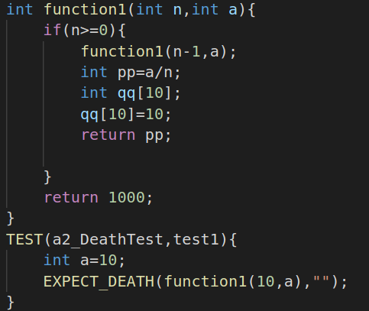
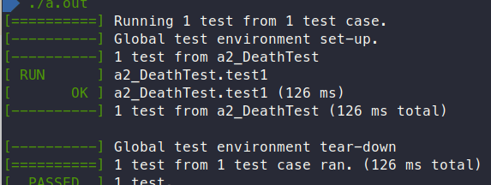
Test example 2
Any other exxample

Slide 14
Test example 2
Any other exxample

Slide 15
Project Example
The Chromium projects (behind the Chrome browser and Chrome OS).
The LLVM compiler.
Protocol Buffers, Google's data interchange format.
The OpenCV computer vision library.
tiny-dnn: header only, dependency-free deep learning framework in C++11.

Slide 16
Limitations
Google Test is designed to be thread-safe. The implementation is thread-safe on systems where the pthreads library is available. It is currently unsafe to use Google Test assertions from two threads concurrently on other systems (e.g. Windows). In most tests this is not an issue as usually the assertions are done in the main thread.

Slide 17
Platforms
Linux
Mac OS X
Windows
Cygwin
MinGW
Windows Mobile
Symbian
PlatformIO
Data taken from https://github.com/google/googletest/

Slide 18
Requirements (Linux)
GNU-compatible Make or gmake
POSIX-standard shell
POSIX(-2) Regular Expressions (regex.h)
A C++11-standard-compliant compiler

Slide 19
Requirements (Windows)
Microsoft Visual C++ 2015 or newer

Slide 20
Requirements (Cygwin)
Cygwin v1.5.25-14 or newer

Slide 21
Requirements (Mac Os X)
Mac OS X v10.4 Tiger or newer
Xcode Developer Tools

Slide 22
References
https://github.com/google/googletest
https://github.com/google/googletest/blob/master/googletest/docs/primer.md
https://github.com/google/googletest/blob/master/googlemock/README.md
https://en.wikipedia.org/wiki/XUnit

